Slide 1
CHAPTER 4:
Data Formats
The Architecture of Computer Hardware, Systems Software & Networking:
An Information Technology Approach
5th Edition, Irv Englander
John Wiley and Sons ©2013
PowerPoint slides authored by Angela Clark, University of South Alabama
PowerPoint slides for the 4th edition were authored by Wilson Wong, Bentley University

Slide 2
Data Formats
Computers and computer-based devices
  Process and store all forms of data in binary format
Human communication
  Includes language, images and sounds
Data formats
  Specifications for converting data into computer-usable form
  Define the different ways human data may be represented, stored and processed by a computer
Copyright 2013 John Wiley & Sons, Inc.
4-<number>

Slide 3
Sources of Data
Binary input
  Begins as discrete input
  Example: keyboard input such as A 1+2=3 math
  Keyboard generates a binary number code for each key
Analog
  Continuous data such as sound or images
  Requires hardware to convert data into binary numbers
Computer
1101000101010101…
A 1+2=3 math
Input device
Copyright 2013 John Wiley & Sons, Inc.
4-<number>

Slide 4
Common Data Representations
Type of Data | Standard(s)
Alphanumeric | Unicode, ASCII, EDCDIC
Image (bitmapped) | GIF (graphical image format) TIFF (tagged image file format) PNG (portable network graphics)
Image (object) | PostScript, JPEG, SWF (Adobe Flash), SVG
Outline graphics and fonts | PostScript, TrueType
Sound | WAV, AVI, MP3, MIDI, WMA
Page description | PDF (Portable Document Format), HTML, XML
Video | Quicktime, MPEG-2, MPEG-4, WMV
Copyright 2013 John Wiley & Sons, Inc.
4-<number>

Slide 5
Internal Data Representation
Reflects the
  Complexity of input source
  Type of processing required
Trade-offs
  Accuracy and resolution
    Simple photo vs. figure in an art book
  Compactness (storage and transmission)
    More data required for improved accuracy and resolution
    Compression represents data in a more compact form
    Metadata: data that describes or interprets the meaning of data
Copyright 2013 John Wiley & Sons, Inc.
4-<number>

Slide 6
Internal Data Representation
  Ease of manipulation:
    Processing simple audio vs. high-fidelity sound
  Standardization
    Proprietary formats for storing and processing data (WordPerfect vs. Word)
    De facto standards: proprietary standards based on general user acceptance (PostScript)
Copyright 2013 John Wiley & Sons, Inc.
4-<number>

Slide 7
Data Types: Numeric
Used for mathematical manipulation
  Add, subtract, multiply, divide
Types
  Integer (whole number)
  Real (contains a decimal point)
Covered in Chapter 5
Copyright 2013 John Wiley & Sons, Inc.
4-<number>

Slide 8
Data Types: Alphanumeric
Alphanumeric:
  Characters: b T
  Number digits: 7 9
  Punctuation marks: ! ;
  Special-purpose characters: $ &
Numeric characters vs. numbers
  Both entered as ordinary characters
  Computer converts into numbers for calculation
    Examples: Variables declared as numbers by the programmer (Salary$ in BASIC)
  Treated as characters if processed as text
    Examples: Phone numbers, ZIP codes
Copyright 2013 John Wiley & Sons, Inc.
4-<number>

Slide 9
Alphanumeric Codes
Arbitrary choice of bits to represent characters
  Consistency: input and output device must recognize same code
  Value of binary number representing character corresponds to placement in the alphabet
    Facilitates sorting and searching
Copyright 2013 John Wiley & Sons, Inc.
4-<number>

Slide 10
Representing Characters
ASCII - most widely used coding scheme
EBCDIC: IBM mainframe (legacy)
Unicode: developed for worldwide use
Copyright 2013 John Wiley & Sons, Inc.
4-<number>

Slide 11
ASCII
Developed by ANSI (American National Standards Institute)
Represents
  Latin alphabet, Arabic numerals, standard punctuation characters
  Plus small set of accents and other European special characters
ASCII
  7-bit code: 128 characters
Copyright 2013 John Wiley & Sons, Inc.
4-<number>

Slide 12
ASCII Reference Table
MSD LSD | 0 | 1 | 2 | 3 | 4 | 5 | 6 | 7
0 | NUL | DLE | SP | 0 | @ | P |  | p
1 | SOH | DC1 | ! | 1 | A | Q | a | W
2 | STX | DC2 | “ | 2 | B | R | b | r
3 | ETX | DC3 | # | 3 | C | S | c | s
4 | EOT | DC4 | $ | 4 | D | T | d | t
5 | ENQ | NAK | % | 5 | E | U | e | u
6 | ACJ | SYN | & | 6 | F | V | f | v
7 | BEL | ETB | ‘ | 7 | G | W | g | w
8 | BS | CAN | ( | 8 | H | X | h | x
9 | HT | EM | ) | 9 | I | Y | i | y
A | LF | SUB | * | : | J | Z | j | z
B | VT | ESC | + | ; | K | [ | k | {
C | FF | FS | , | < | L | \ | l | |
D | CR | GS | - | = | M | ] | m | }
E | SO | RS | . | > | N | ^ | n | ~
F | SI | US | / | ? | O | _ | o | DEL
74₁₆
111 0100
Copyright 2013 John Wiley & Sons, Inc.
4-<number>

Slide 13
EBCDIC
Extended Binary Coded Decimal Interchange Code developed by IBM
  Restricted mainly to IBM or IBM compatible mainframes
  Conversion software to/from ASCII available
  Common in archival data
  Character codes differ from ASCII
 | ASCII | EBCDIC
Space | 20₁₆ | 40₁₆
A | 41₁₆ | C1₁₆
b | 62₁₆ | 82₁₆
Copyright 2013 John Wiley & Sons, Inc.
4-<number>

Slide 14
Unicode
Most common 16-bit form represents 65,536 characters
ASCII Latin-I subset of Unicode
  Values 0 to 255 in Unicode table
Multilingual: defines codes for
  Nearly every character-based alphabet
  Large set of ideographs for Chinese, Japanese and Korean languages
  Composite characters for vowels and syllabic clusters required by some languages
Allows software modifications for local-languages
Copyright 2013 John Wiley & Sons, Inc.
4-<number>

Slide 15
Collating Sequence
Alphabetic sorting if software handles mixed upper- and lowercase codes
In ASCII, numbers collate first; in EBCDIC, last
ASCII collating sequence for string of characters
Letters |  |  |  |  |  |  |  |  | Numeric Characters
Adam | A | d | a | m |  |  |  |  | 1 | 011 | 0001
Adamian | A | d | a | m | i | a | n |  | 12 | 011 | 0001 | 011 | 0010
Adams | A | d | a | m | s |  |  |  | 2 | 011 | 0010
Copyright 2013 John Wiley & Sons, Inc.
4-<number>

Slide 16
2 Classes of Codes
Printing characters
  Produced on the screen or printer
Control characters
  Control position of output on screen or printer
  Cause action to occur
  Communicate status between computer and I/O device
VT: vertical tab | LF: Line feed
BEL: bell rings | DEL: delete current character
ESC: provides extensions by changing the meaning of a specified number of contiguous following characters
Copyright 2013 John Wiley & Sons, Inc.
4-<number>

Slide 17
Visual Data
Videos, photographs, biometric images, figures, icons, drawings, charts and graphs
Two approaches:
  Bitmap or raster images of photos and paintings with continuous variation
  Object or vector images composed of graphical objects like lines and curves defined geometrically
Differences include:
  Quality of the image
  Storage space required
  Time to transmit
  Ease of modification
Copyright 2013 John Wiley & Sons, Inc.
4-<number>

Slide 18
Bitmap Images
Used for realistic images with continuous variations in shading, color, shape and texture
Preferred when image contains large amount of detail and processing requirements are fairly simple
Input devices:
  Scanners
  Digital cameras and video capture devices
  Graphical input devices like mice and pens
Managed by photo editing software or paint software
Copyright 2013 John Wiley & Sons, Inc.
4-<number>

Slide 19
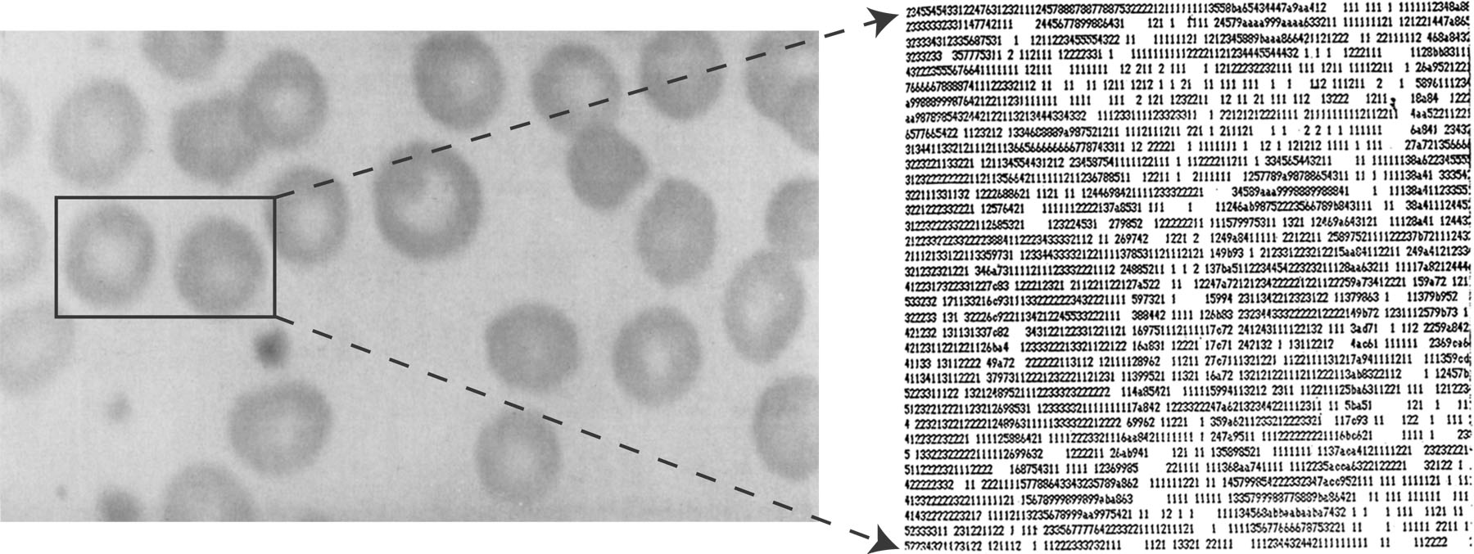
Bitmap Images
Each individual pixel, for pi[x]cture element, in a graphic is stored as a binary number
  Pixel: A small area with an associated coordinate location
  Example: each point below represented by a 4-bit code corresponding to 1 of 16 shades of gray
Copyright 2013 John Wiley & Sons, Inc.
4-<number>

Slide 20
Bitmap Display
Monochrome: black or white
  1 bit per pixel
Gray scale: black, white or 254 shades of gray
  1 byte per pixel
Color graphics: 16 colors, 256 colors, or 24-bit true color (16.7 million colors)
  4, 8, and 24 bits respectively
Copyright 2013 John Wiley & Sons, Inc.
4-<number>

Slide 21
Storing Bitmap Images
Frequently large files
  Example: 768 rows of 1024 pixels with 1 byte for each of 3 colors ~2.4MB file
File size affected by
  Resolution (the number of pixels per inch)
    Amount of detail affecting clarity and sharpness of an image
  Levels: number of bits for displaying shades of gray or multiple colors
    Palette: color translation table that uses a code for each pixel rather than actual color value
  Data compression
Copyright 2013 John Wiley & Sons, Inc.
4-<number>

Slide 22
GIF (Graphics Interchange Format)
First developed by CompuServe in 1987
GIF89a enabled animated images
  Allows images to be displayed sequentially at fixed time sequences
Color limitation: 256
Image compressed by LZW (Lempel-Zif-Welch) algorithm
Preferred for line drawings, clip art and pictures with large blocks of solid color
Lossless compression
Copyright 2013 John Wiley & Sons, Inc.
4-<number>

Slide 23
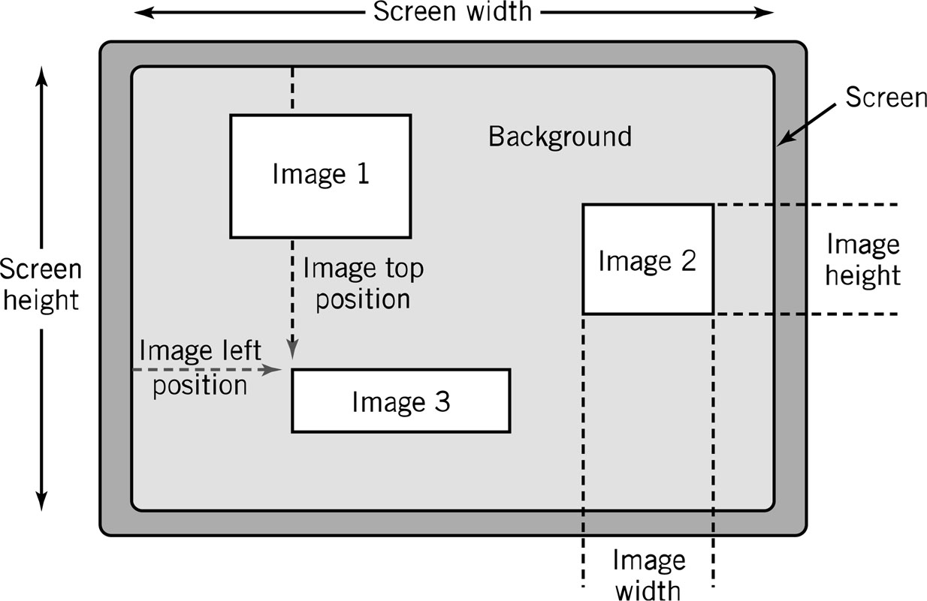
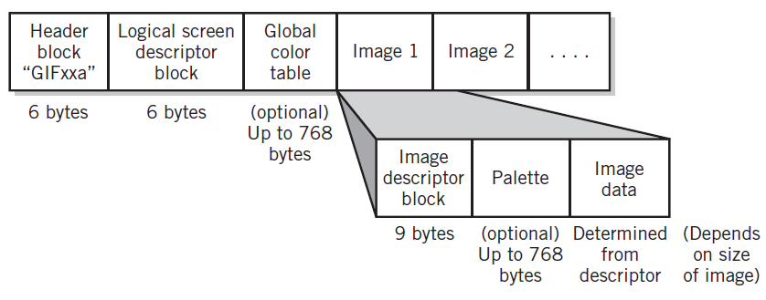
GIF (Graphics Interchange Format)
Copyright 2013 John Wiley & Sons, Inc.
4-<number>

Slide 24
PNG (Portable Network Graphics)
Losslesly-compressed alternative to GIF
Can store up to 48 bits of color per pixel
Can also store transparency percentage value and color correction factor for monitor or printer
More efficient compression algorithm than GIF
Copyright 2013 John Wiley & Sons, Inc.
4-<number>

Slide 25
JPEG
(Joint Photographers Expert Group)
Allows more than 16 million colors
Suitable for highly detailed photographs and paintings
Employs lossy compression algorithm that
  Discards data to decreases file size and transmission speed
  May reduce image resolution, tends to distort sharp lines
Copyright 2013 John Wiley & Sons, Inc.
4-<number>

Slide 26
Object Images
Created by drawing software or output from spreadsheet data graphs
Composed of lines and shapes in various colors
Computer translates geometric formulas to create the graphic
Storage space depends on image complexity
  Number of instructions to create lines, shapes, fill patterns
Movies such as Shrek and Toy Story use object images
Copyright 2013 John Wiley & Sons, Inc.
4-<number>

Slide 27
Object Images
Based on mathematical formulas
  Easy to move, scale, and rotate without losing shape and identity as bitmap images may
Require less storage space than bitmap images
Cannot represent photos or paintings
Cannot be displayed or printed directly
  Must be converted to bitmap since output devices except plotters are bitmap
Copyright 2013 John Wiley & Sons, Inc.
4-<number>

Slide 28
PostScript
Page description language: list of procedures and statements that describe each of the objects to be printed on a page
  Stored in ASCII or Unicode text file
  Interpreter program in computer or output device reads PostScript to generate image
Scalable font support
  Font outline objects specified like other objects
Copyright 2013 John Wiley & Sons, Inc.
4-<number>

Slide 29
Bitmap vs. Object Images
Bitmap (Raster) | Object (Vector)
Pixel map | Geometrically defined shapes
Photographic quality | Complex drawings
Paint software | Drawing software
Larger storage requirements | Higher computational requirements
Enlarging images produces jagged edges | Objects scale smoothly
Resolution of output limited by resolution of image | Resolution of output limited by output device
Copyright 2013 John Wiley & Sons, Inc.
4-<number>

Slide 30
Video Images
Require massive amount of data
  Video camera producing full screen 1024 x 768 pixel true color image at 30 frames/sec 70.8 MB of data/sec
  1-minute film clip 4.25 GB storage
Options for reducing file size: decrease size of image, limit number of colors, or reduce frame rate
Video format determined by a codec, encoder/decoder
Copyright 2013 John Wiley & Sons, Inc.
4-<number>

Slide 31
Video Images
Best known codec standards: MPEG-2, MPEG-4, and H.264
  Data may be compressed to 10-60 MB or less of data per minute
Container serves as a superstructure to encode, decode, hold and stream the video
  Examples: Quicktime from Apple, WebM from Google, and Flash Video from Adobe
Streaming video: video displayed in real time as it is downloaded from the Web server
Copyright 2013 John Wiley & Sons, Inc.
4-<number>

Slide 32
Audio Data
Transmission and processing requirements less demanding than those for video
Analog Waveform: digital representation of sound
Analog sound converted to digital values by A-to-D converter
MIDI (Musical Instrument Digital Interface): instructions to recreate or synthesize sounds
Copyright 2013 John Wiley & Sons, Inc.
4-<number>

Slide 33
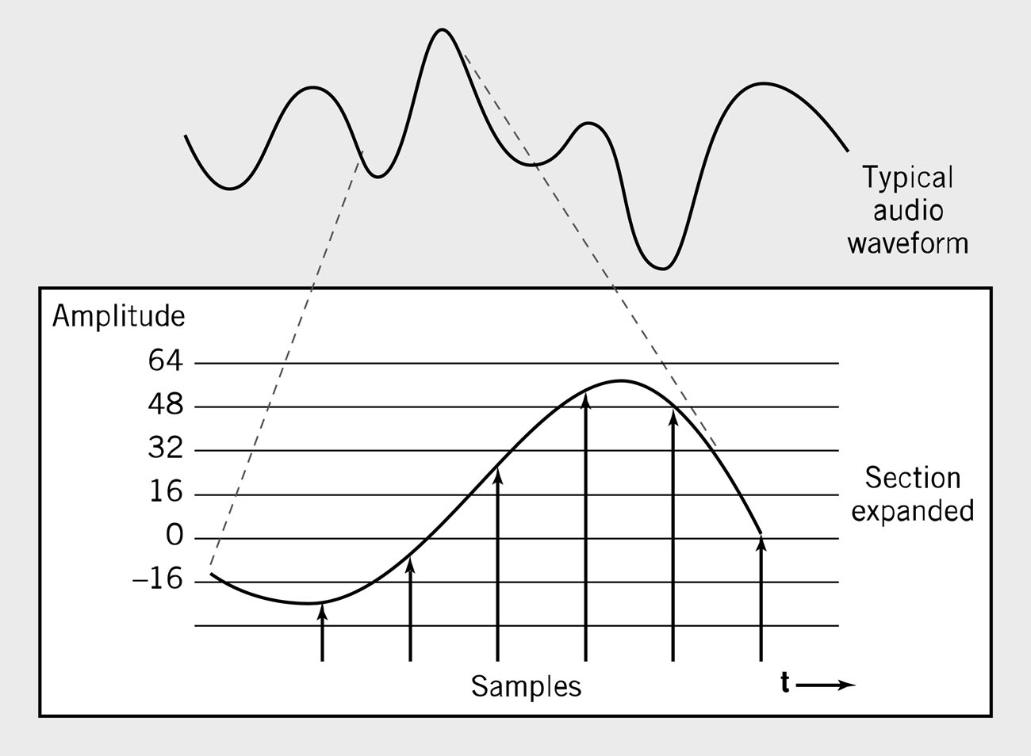
Waveform Audio
Sampling rate normally 50KHz
Copyright 2013 John Wiley & Sons, Inc.
4-<number>

Slide 34
Sampling Rate
Number of times per second that sound is measured during the recording process.
  1000 samples per second = 1 KHz (kilohertz)
  Example: Audio CD sampling rate = 44.1KHz
Height of each sample saved as:
  8-bit number for radio-quality recordings
  16-bit number for high-fidelity recordings
  2 x 16-bits for stereo
Copyright 2013 John Wiley & Sons, Inc.
4-<number>

Slide 35
Audio Formats
MP3 – predominant digital audio data format
  Derivative of MPEG-2 (ISO Moving Picture Experts Group)
  Uses psychoacoustic lossy compression techniques to reduce storage requirements
WAV
  Developed by Microsoft as part of its multimedia specification
  General-purpose format for storing and reproducing small snippets of sound
  Non-compressed 8- or 16-bit sound samples
Copyright 2013 John Wiley & Sons, Inc.
4-<number>

Slide 36
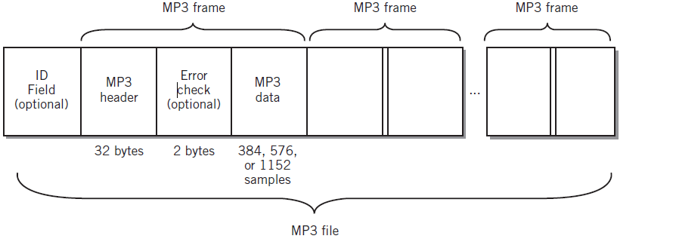
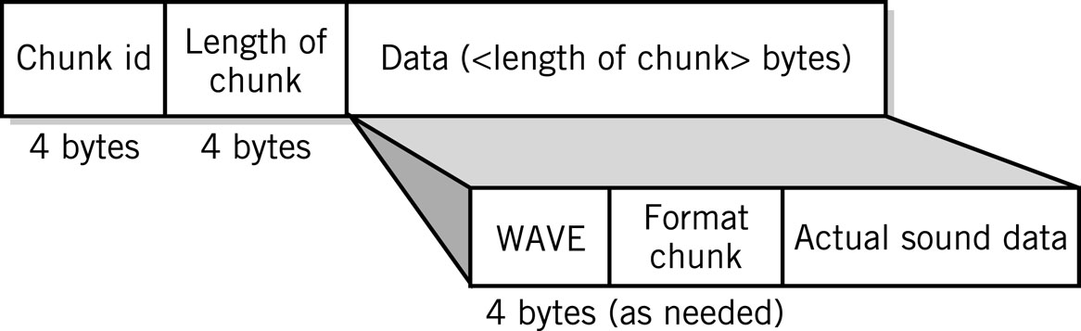
Audio Data Formats
WAV file
Copyright 2013 John Wiley & Sons, Inc.
4-<number>

Slide 37
Data Compression
Compression: recoding data so that it requires fewer bytes of storage space.
Compression ratio: the amount file size is reduced
Lossless: inverse algorithm restores data to exact original form
  Examples: GIF, PCX, TIFF, ZIP
Lossy: trades off data degradation for file size and download speed
  Much higher compression ratios, often 10 to 1
  Example: JPEG, MP3
  Common in multimedia
H.264: uses both forms for ratios of 1000:1
Copyright 2013 John Wiley & Sons, Inc.
4-<number>

Slide 38
Page Description Languages
Describe layout of objects on a displayed or printed page
Objects may include text, object images, bitmap images, multimedia objects, and other data formats
Examples
  HTML, XHTML, XML
  PDF
  Postscript
Copyright 2013 John Wiley & Sons, Inc.
4-<number>

Slide 39
Internal Computer Data Format
All data stored as binary numbers
Interpreted based on
  Operations computer can perform
  Data types supported by programming language used to create application
Copyright 2013 John Wiley & Sons, Inc.
4-<number>

Slide 40
5 Simple Data Types
Boolean: 2-valued variables or constants with values of true or false
Char: Variable or constant that holds alphanumeric character
Enumerated
  User-defined data types with possible values listed in definition
    Type DayOfWeek = Mon, Tues, Wed, Thurs, Fri, Sat, Sun
Integer: positive or negative whole numbers
Real
  Numbers with a decimal point
  Numbers whose magnitude, large or small, exceeds computer’s capability to store as an integer
Copyright 2013 John Wiley & Sons, Inc.
4-<number>

Slide 41
Copyright 2013 John Wiley & Sons
All rights reserved. Reproduction or translation of this work beyond that permitted in section 117 of the 1976 United States Copyright Act without express permission of the copyright owner is unlawful. Request for further information should be addressed to the Permissions Department, John Wiley & Sons, Inc. The purchaser may make back-up copies for his/her own use only and not for distribution or resale. The Publisher assumes no responsibility for errors, omissions, or damages caused by the use of these programs or from the use of the information contained herein.”
Copyright 2013 John Wiley & Sons, Inc.
4-<number>

